Slide 1
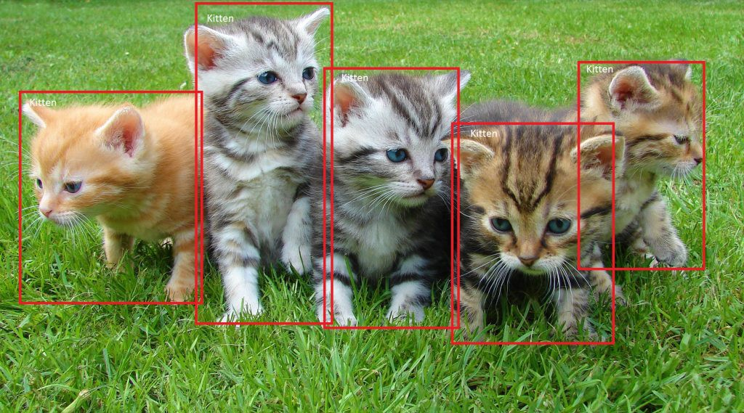
SSD: Single Shot MultiBox Detector 29 Dec 2016 UNC Chapel Hill, Zoox Inc., Google Inc. and University of Michigan, Ann-Arbor
Daniel Kovachev & Yuval Amrami
Example of end-to-end object detection in a Box (from Microsoft)

Slide 2
Problem Definition
Given an image as input
Predict bounding boxes and class labels for each object in the image.
Object Detection

Slide 3
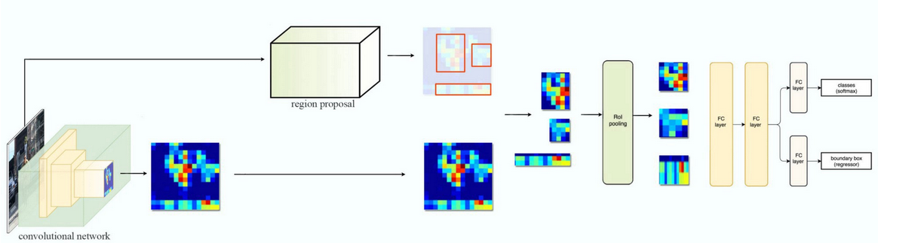
Fast R-CNN

Slide 4
Fast R-CNN Problems
Training phase is too long
Training happens in multiple phases (e.g. training region proposal vs classifier)
Network is too slow at inference time(2 seconds)

Slide 5
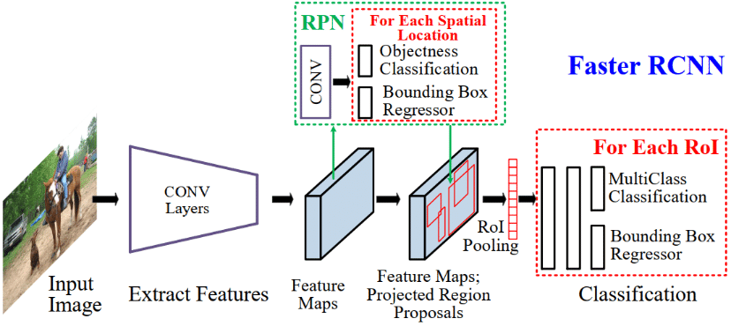
Faster R-CNN

Slide 6
Faster R-CNN Problems
Training phase is too long
Network is too slow at inference time (0.2 seconds)

Slide 7
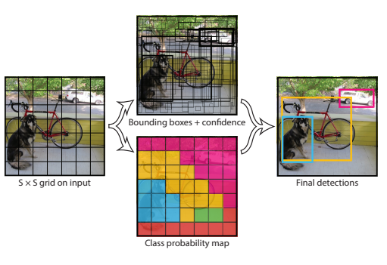
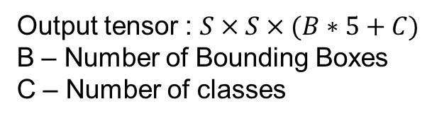
YOLO – You Only Look Once
Output tensor : $S×S×(B∗5+C)$
B – Number of Bounding Boxes
C – Number of classes

Slide 8
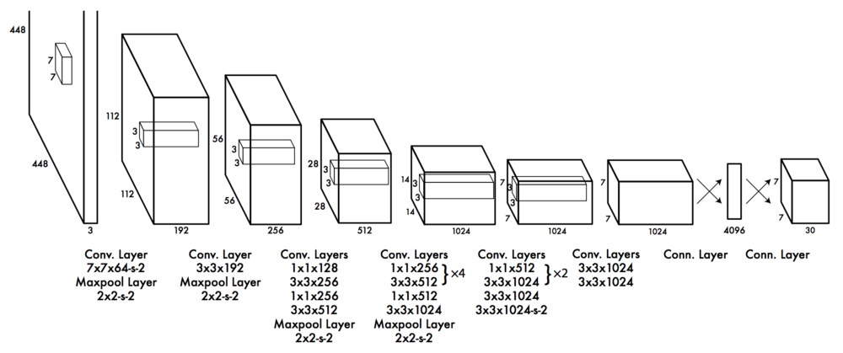
YOLO – You Only Look Once

Slide 9
YOLO Problems
Low Accuracy compared to Faster R-CNN.
Struggle with small objects.
Bounding boxes aren't optimal(Loss function)

Slide 10
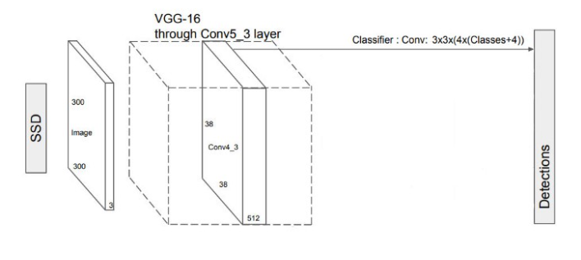
Single Shot MultiBox Detector
extract features
predict class probabilities & bounding boxes location

Slide 11
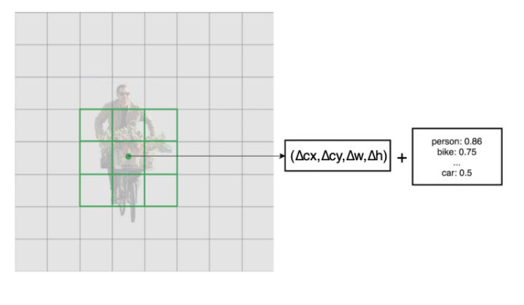
Single Shot MultiBox Detector
output prediction (C + 4)*B
each conv layer output M*N*B*(C+4)

Slide 12
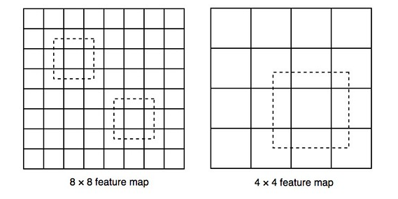
Single Shot MultiBox Detector
bigger feature maps detect smaller objects
Smaller feature maps detect bigger objects

Slide 13
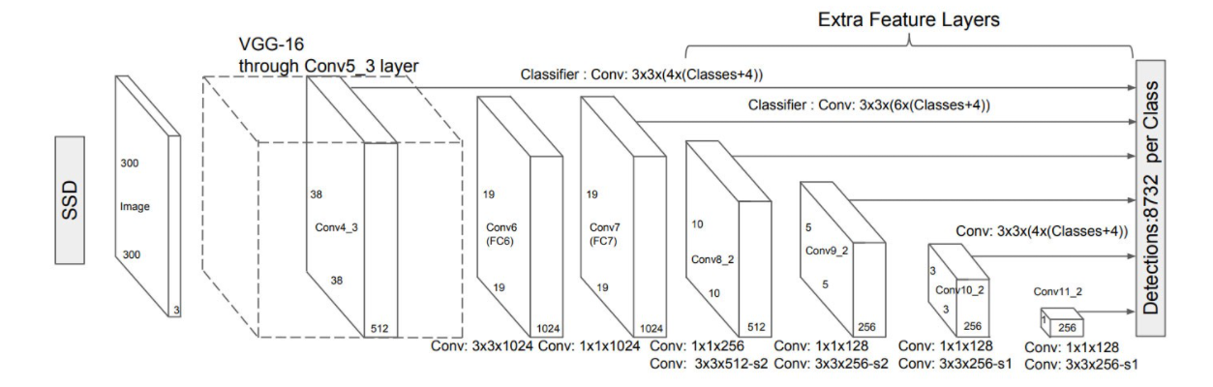
Single Shot MultiBox Detector

Slide 14
Choosing Bounding Boxes

Slide 15
Matching Strategy

Slide 16
Loss Function

Slide 17
Training

Slide 18
Data Augmention

Slide 19
Results

Slide 20
Problems

Slide 21
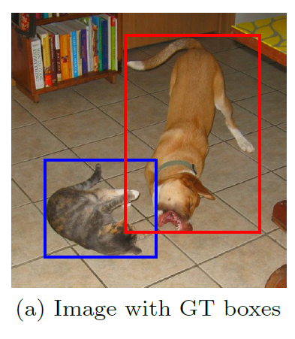
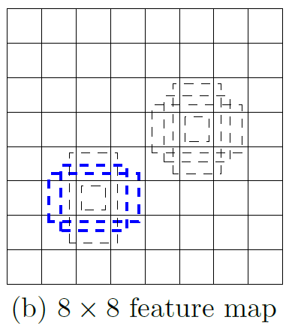
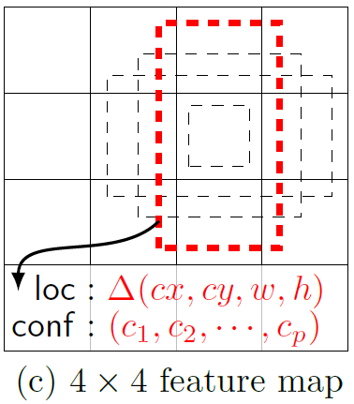
Single Shot MultiBox Detector
74% mAP (mean Average Precision) at 59 frames per second on standard datasets such as PascalVOC and COCO
Single Shot: The tasks of object localization and classification are done in a single forward pass of the network
MultiBox: the name of a technique for bounding box regression, developed by Szegedy et al.
Detector: The network is an object detector that also classifies those detected objects
(from SSD paper)

Slide 22
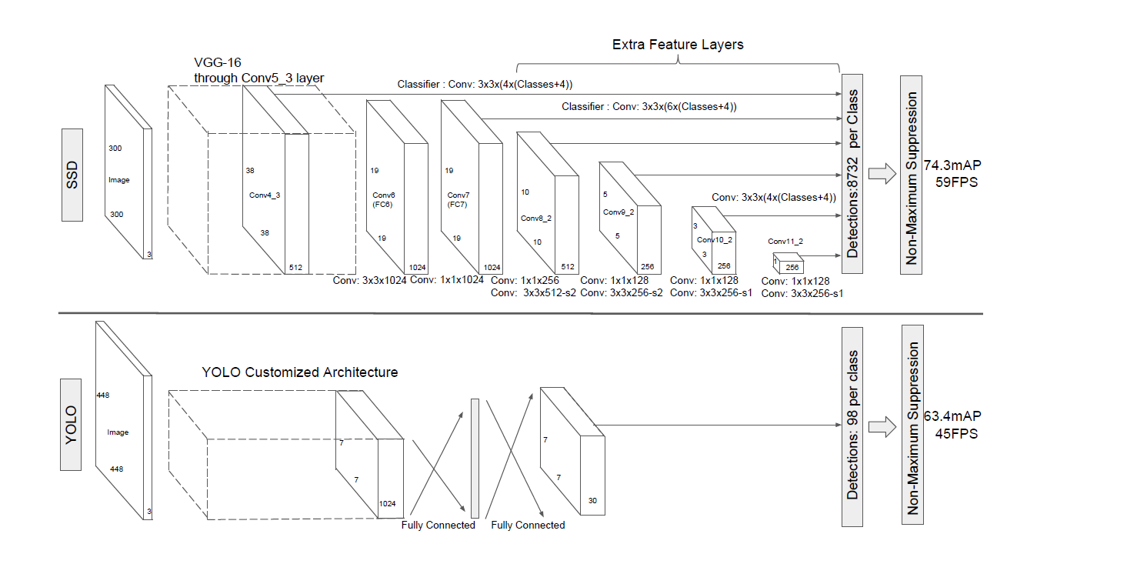
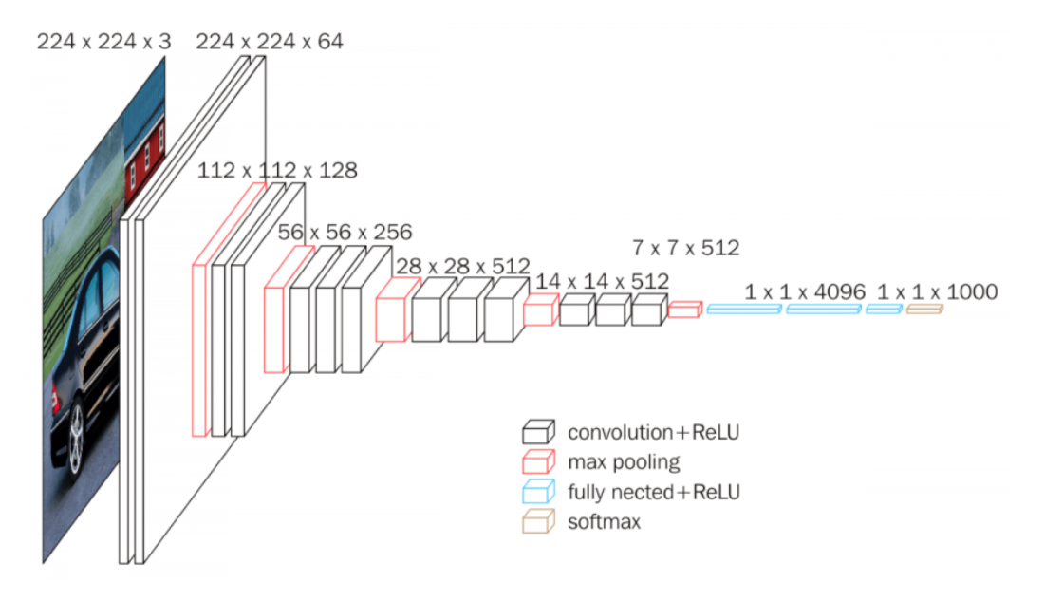
Architecture
SSD and YOLO architecture (from SSD paper)
VGG-16 architecture (from Neurohive)
Notes:
VGG-16 נבחרה בגלל יעילות אבל הופרדה משכבות מחוברות לחלוטין לשכבות עזר בממדים שונים

Slide 23
References
Understanding SSD MultiBox — Real-Time Object Detection In Deep Learning by Eddie Forson, Nov 18, 2017
Click to edit Bullet Point
Click to edit Bullet Point
Click to edit Bullet Point
Click to edit Bullet Point
Click to edit Bullet Point

Slide 24
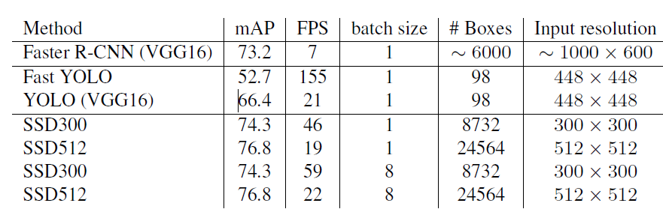
מה עוד
תהליך אימון?
סינון תוצאות עם כמות התאמות גדולה?
מתמטיקה?
תוצאות על המאגרים השונים?
תיאור של ההשוואה בין מולטי בוקס לSSD?
דוגמאות
נקודות תורפה שנשארו במערכת?
Click to edit Bullet Point
Click to edit Bullet Point
Click to edit Bullet Point
Click to edit Bullet Point
Click to edit Bullet Point

Slide 25

Thank you.

Slide 26
Text slide
Click to edit Bullet Point
Click to edit Bullet Point
Click to edit Bullet Point
Click to edit Bullet Point
Click to edit Bullet Point
Click to edit Bullet Point

Slide 27
Text slide
Subtitle
Click to edit Bullet Point
Click to edit Bullet Point
Click to edit Bullet Point
Click to edit Bullet Point
Click to edit Bullet Point
Click to edit Bullet Point

Slide 28

Text + Picture
Click to edit Bullet Point
Click to edit Bullet Point
Click to edit Bullet Point
Click to edit Bullet Point
Click to edit Bullet Point
Click to edit Bullet Point

Slide 29
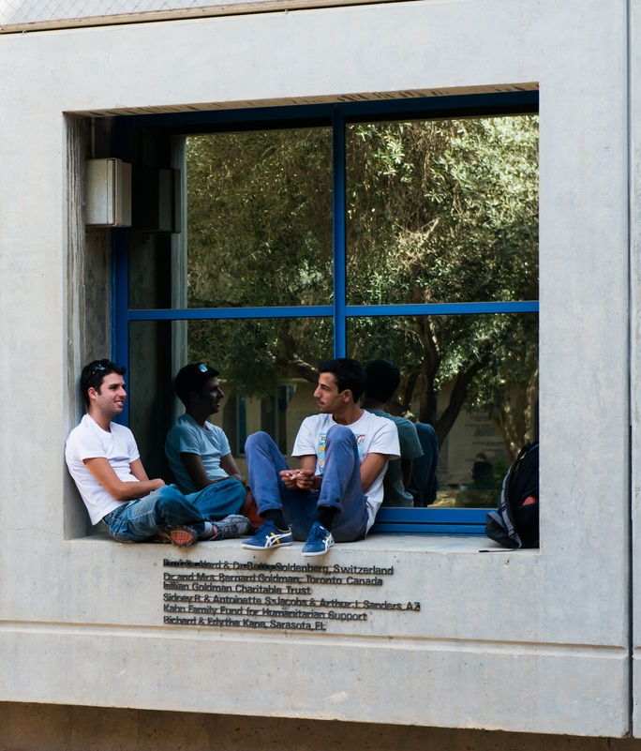
Text + Picture 2
Click to edit Bullet Point
Click to edit Bullet Point
Click to edit Bullet Point
Click to edit Bullet Point
Click to edit Bullet Point
Click to edit Bullet Point

Slide 30

Text + Picture 3
Click to edit Bullet Point
Click to edit Bullet Point
Click to edit Bullet Point
Click to edit Bullet Point
Click to edit Bullet Point
Click to edit Bullet Point

Slide 31

Text + Picture 4

Slide 32
Graph slide

Slide 33
Graph slide
Click to edit Bullet Point
Click to edit Bullet Point
Click to edit Bullet Point
Click to edit Bullet Point
Click to edit Bullet Point
Click to edit Bullet Point
Graph title

Slide 34
Icon bank

Slide 35
Icon bank

